Slide 1
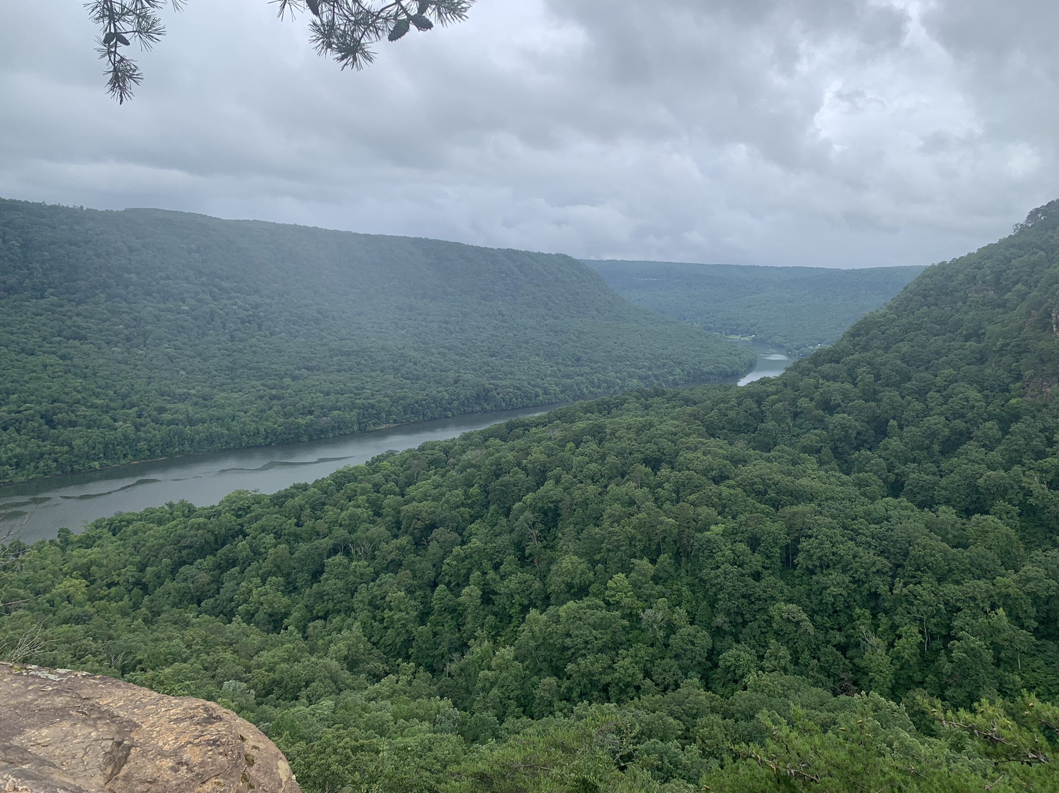
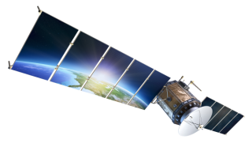
Mapping Tree Canopy in Signal Mountain, TN Using Remote Sensing and GIS
Dr. Azad Hossain
Department of Biology, Geology and Environmental Science
The University of Tennessee at Chattanooga
TNGIC Eastern Fall Forum, University of Tennessee at Chattanooga
October 17, 2023
Patrick Bassham
Jared Stein
Spencer Cox

Slide 2
Problem Statement
Trees provide numerous benefits, including improvements in air quality, storm water runoff, reduces erosion and pollution, and provides food, habitats, and protection for animals. These benefits also have an economic value to our society.
Our project is looking at the tree canopy coverage on Signal Mountain, and in the city of Walden in Hamilton County.
In recent research, by Bruce Webster, tree canopy coverage on Signal Mt. has decreased from 1997 to 2010. Our research was focused on tree canopy coverage on Signal Mt. from 2010 to 2021.

Slide 3
Goals and Objectives
Our main goal is to assess the change in tree canopy coverage between the years of 2010 and 2021 in the towns of Signal Mountain and Walden.
Our project is a follow-up report on the 2012 Signal Mountain Tree Canopy Report prepared by Bruce Webster. To do this, we will be performing three different types of analyses: unsupervised classification, NDVI, and a dot-grid analysis, The dot-grid analysis is being performed to keep methodology consistent between Webster’s 2012 report and our own.

Slide 4
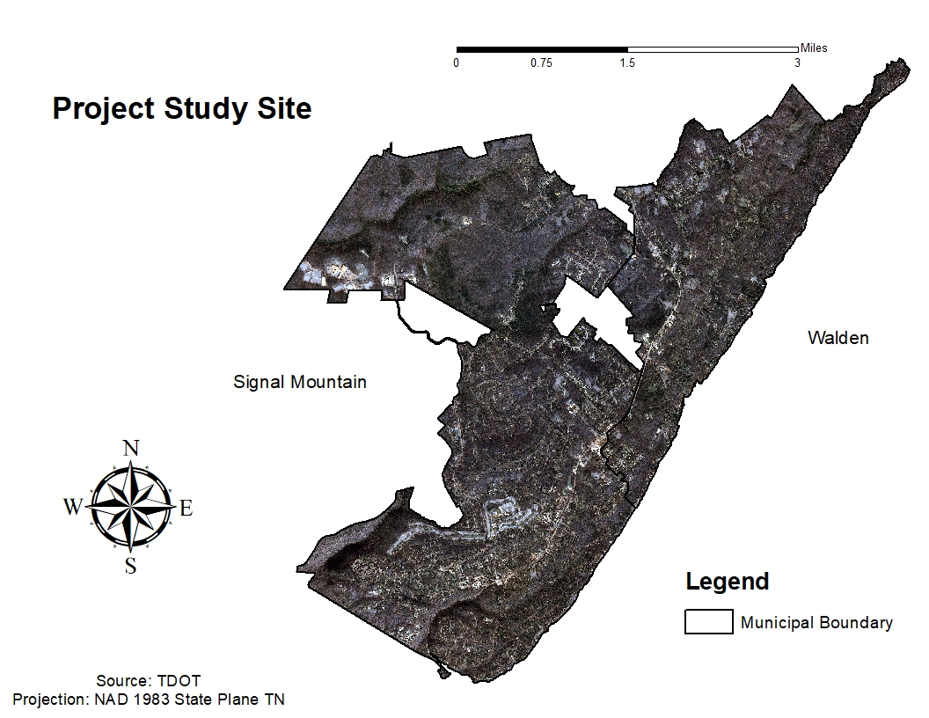

Slide 5


Data Requirements and Availability
We are using data from several different sources including TNGIC (Tennessee Geographic Information Council), NAIP (National Agricultural Imagery Program) from the USDA (United States Department of Agriculture) and TDOT (Tennessee Department of Transportation).
We obtained the Signal Mountain and Walden shapefile from TNGIC.
We retrieved TDOT imagery from years 2010 to 2018 with a spatial resolution of 1ft. x 1ft for the 2010 image and 0.8ft x 0.8ft for the 2018 image.
We retrieved NAIP imagery from years 2010 to 2021 with a spatial resolution of 1m. x 1m for the 2010 image and 0.6m x 0.6m for the 2021 image.

Slide 6
Methodology
In our project we used three methods of analyses, a dot-grid analysis, unsupervised classification, and NDVI.
Unsupervised classification was performed on the 2010 - 2021 NAIP data and the 2010 - 2018 TDOT data.
We calculated the NDVI for the 2018 TDOT image and the 2021 NAIP image. The 2010 NAIP and TDOT images did not have a NIR band to measure NDVI.
The dot-grid analysis method was performed on the 2021 NAIP data and the 2010 - 2018 TDOT data.
Dot-grid analysis only needed to be performed on one 2010 image.
Data Preparation: Both 2010 images contained only the blue, green, and red bands. The clipped 2010 images were created using the “Extract By Mask” tool in ArcMap with the Signal Mountain boundary used as the mask. The 2021 NAIP image originally came as two separate images each with three bands: one true color (blue, green, red) and one false color (NIR, green, red). To create the 2021 NAIP image with 4 bands, the NIR band was isolated from the false color image using a spectral subset tool and subsequently added to the true color image using the “Layer Stack” tool in ERDAS Imagine. The 2018 TDOT image came with 4 bands (BGR & NIR). Then, the clipped 2018 TDOT and 2021 NAIP images were created using the “Extract By Mask” tool in ArcMap with the Signal Mountain boundary used as the mask.

Slide 7
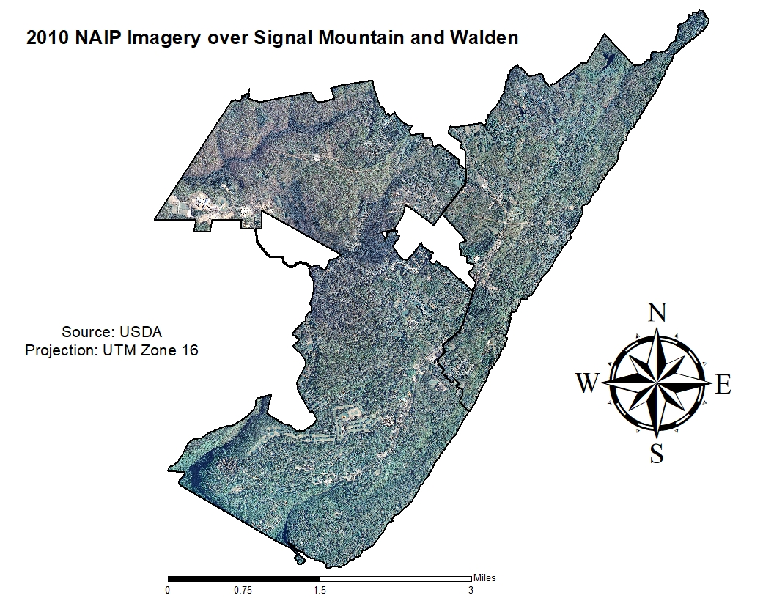
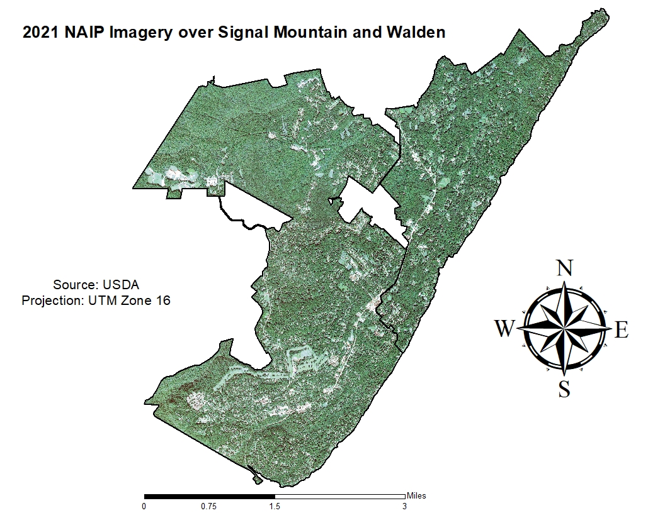

Slide 8
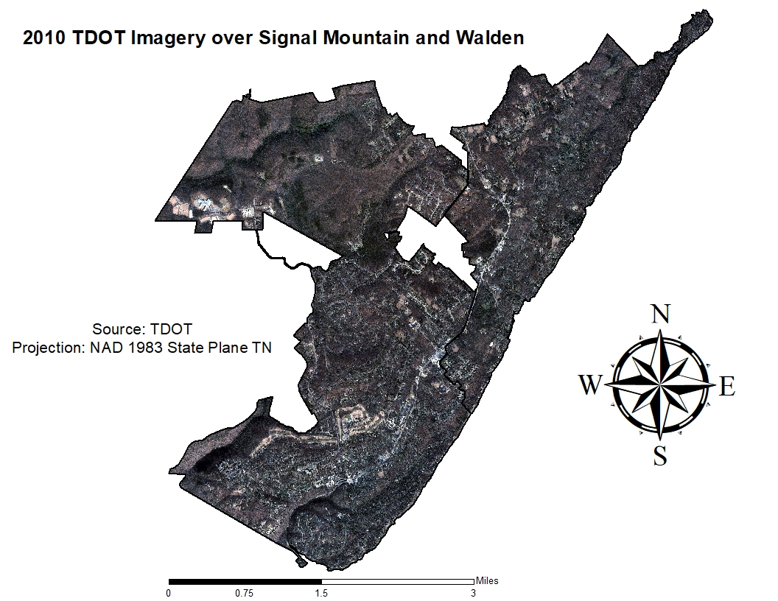
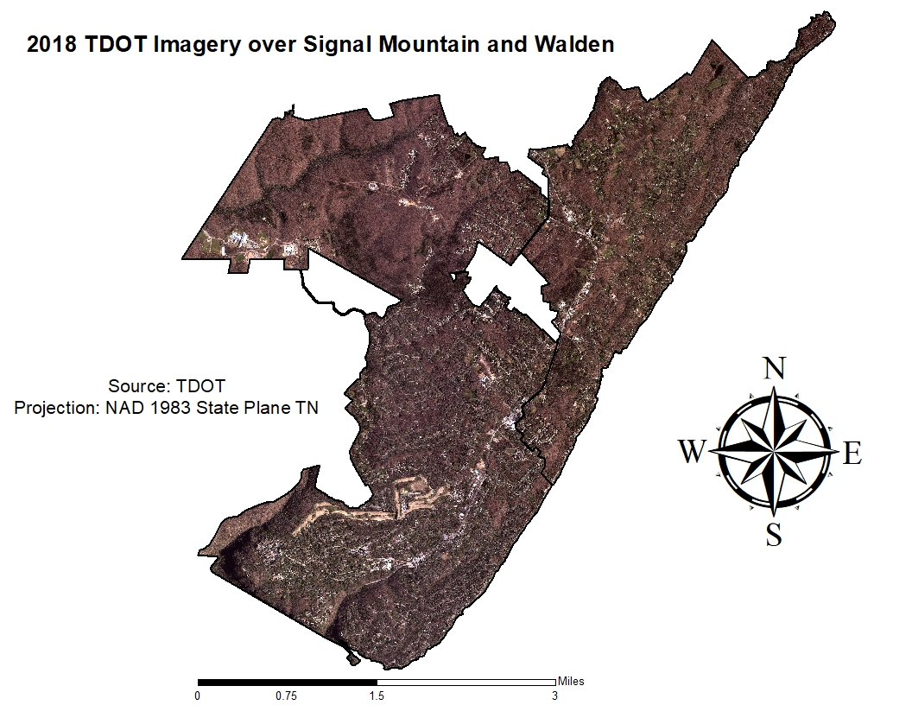

Slide 9
Methodology (cont.)
Unsupervised Classification: The “Unsupervised Classification” tool in ERDAS Imagine was used on all 4 images. We used the “K-means” classification method and kept the default parameter of 36 classes. Then, each class was assigned a 1 if it predominantly represented canopy cover and a 2 if it predominantly represented impervious surfaces. The “Reclassify” tool in ArcMap was used to produce a new, 2-class thematic image.
NDVI: The 4-band 2018 and 2021 images were ran through the “Indices” tool in ERDAS Imagine which produced a panchromatic image. The panchromatic NDVI images were brought into ArcGIS Pro and the histogram associated with each image along with the original 2018 and 2021 images were used as references to find the threshold value that separated canopy cover from impervious surfaces. Once that value was identified, the “Reclassify” tool in ArcMap was used to produce a new, 2-class thematic image.
Dot Grid Analysis: The “Create Fishnet” tool in ArcGIS Pro was used to create a grid with dots inside each cell. The “Buffer” tool was used to create a feature class with circular polygons around each dot. Then, the “Select by Location” tool was used to select all circular polygons inside the Signal Mountain boundary. The rest of the circular polygons were deleted from the attribute table by inverting the aforementioned selection and pressing “Delete Rows”. A new field was created inside the attribute table of this feature class called “Canopy” so that each dot could be classified as canopy or impervious surface coverage. This feature class was overlaid on the three images and each dot was zoomed in on to determine its coverage type.

Slide 10
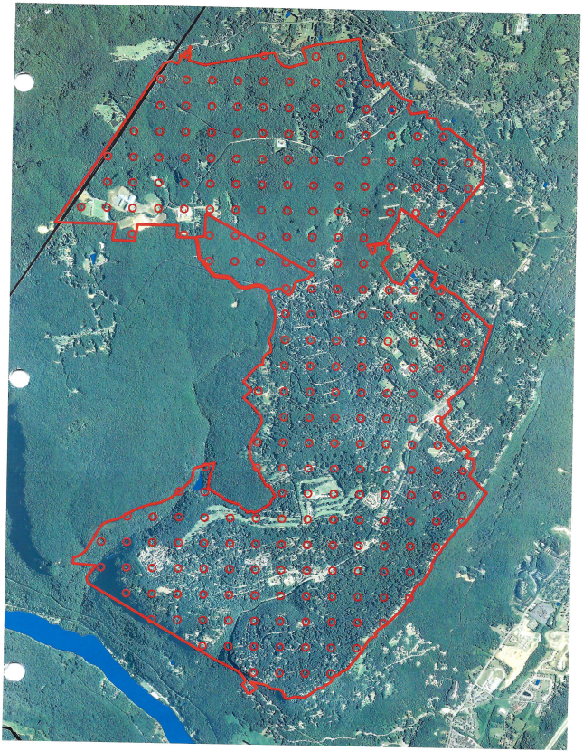
Dot Grid Analysis from 2012 report
A dot-grid was overlaid on top of the 1997 and 2010 imagery and the dots outside the Signal Mountain boundary were clipped out.
Two different grids were overlaid, one with 1/4 mile spacing between each dot and one with 3/16 mile spacing. The 3/16 mile dot grid was found to be less susceptible to error when calculating coverage results.
Then, the dots were manually classified into 3 classes (canopy, impervious, and other) by zooming in on each dot and visually determining the predominant land cover type.
Canopy and impervious surface coverage were calculated by dividing the number of points in each class by the total number of points inside the Signal Mountain boundary.
 | 1997 | 2010
Impervious Surface | 12.2% (25.7%) | 12.2% (26.5%)
Canopy Coverage | 74.3% | 73.5%

Slide 11
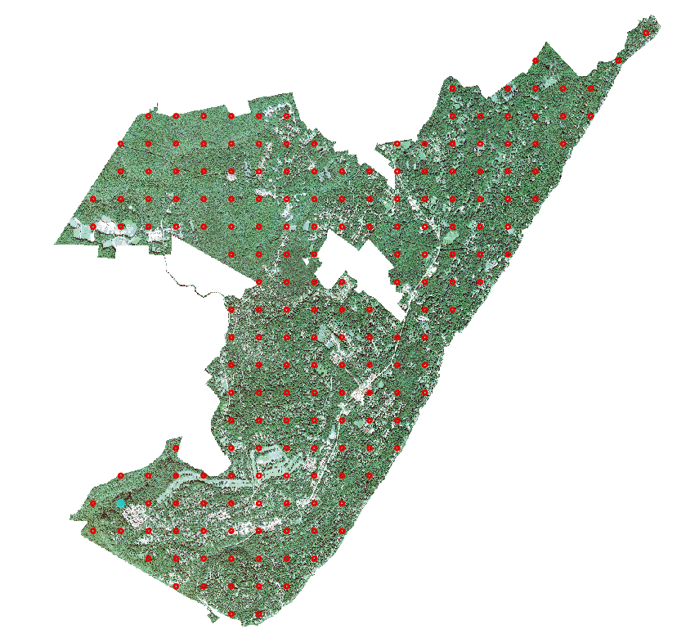
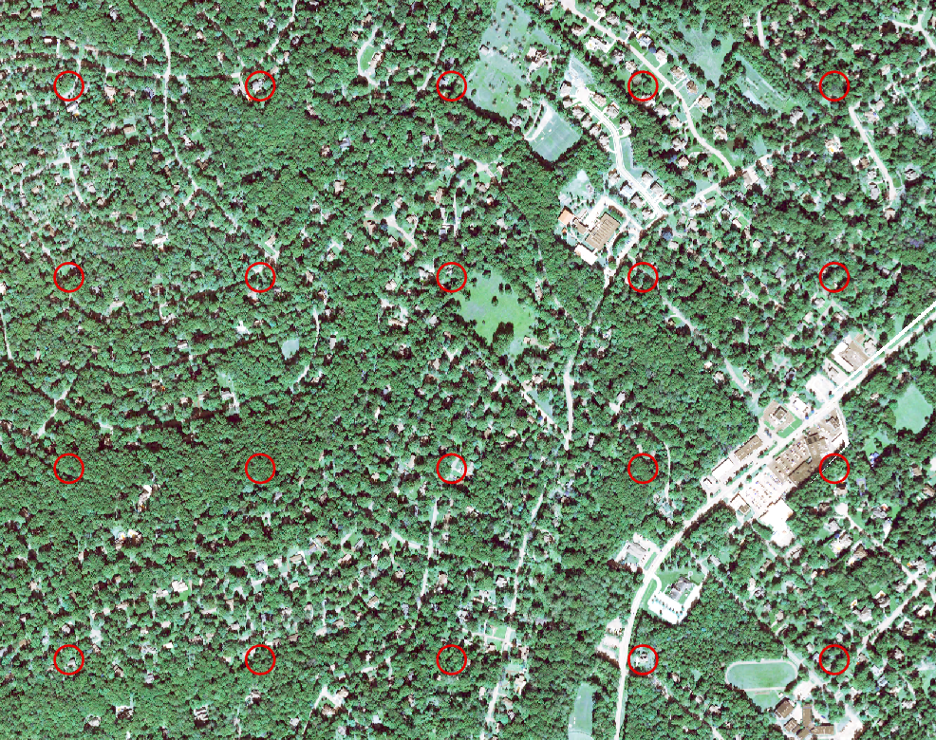
Our Dot Grid Analysis
Our dot-grid analysis differed from the analysis in the 2012 report in 3 main ways.
Points were classified into 2 classes instead of 3 (canopy and impervious surfaces).
Canopy and impervious surface coverage was calculated for Signal Mountain and Walden jointly.
The spacing between each dot was 1/4 mile instead of 3/16 mile.
To make our results comparable to the 2012 report, we combined the percentages obtained from the impervious surface and “other” classes (see previous slide).

Slide 12
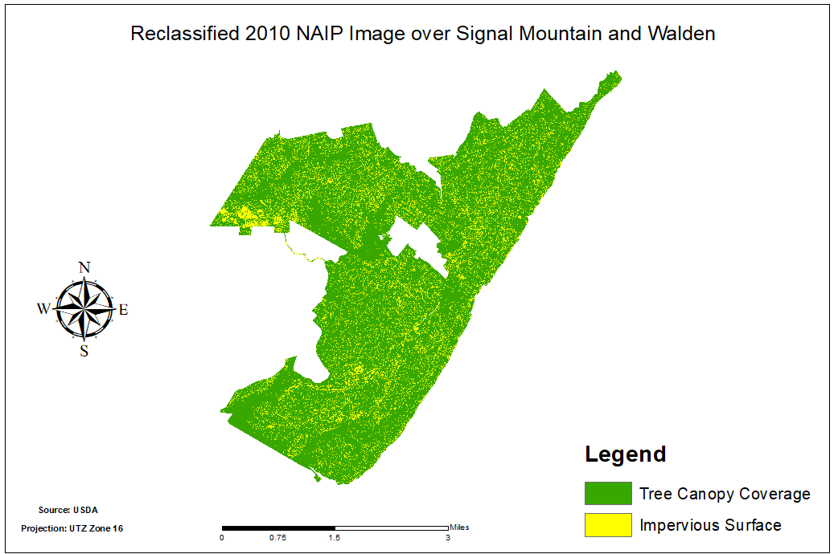
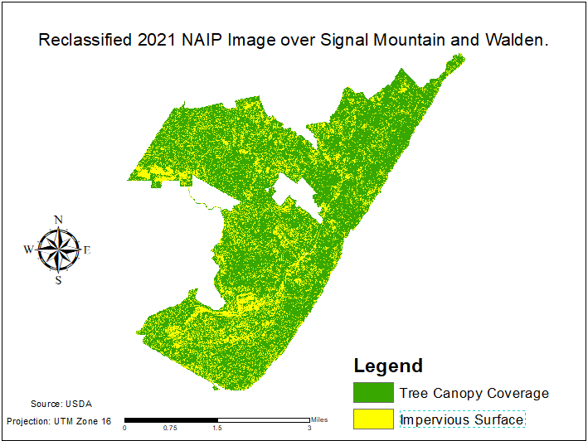
Unsupervised NAIP Data from 2010 to 2021

Slide 13
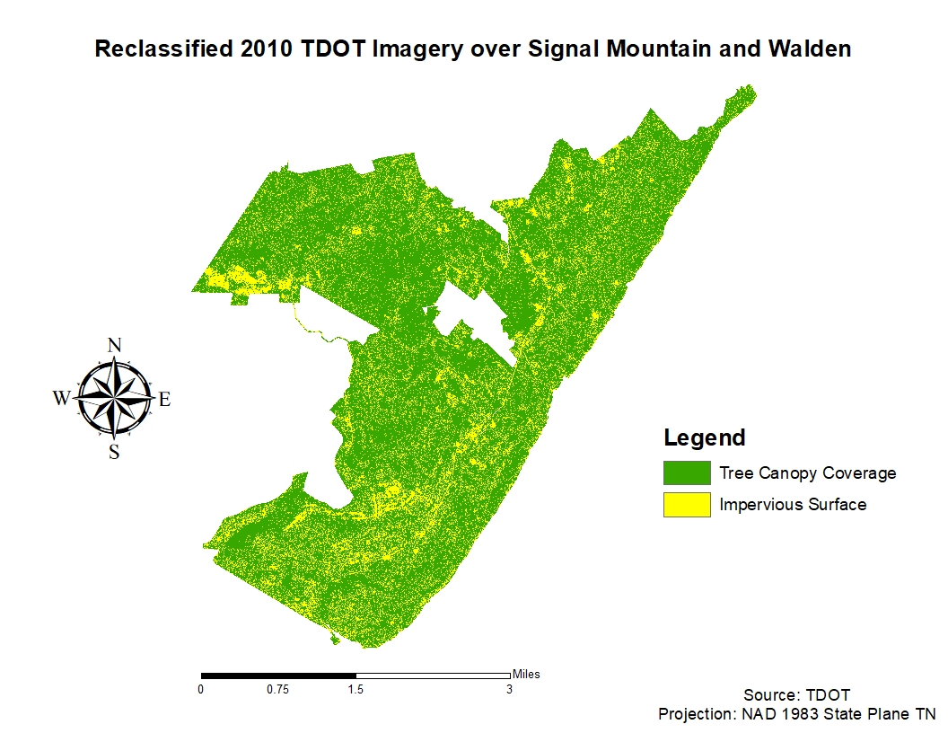
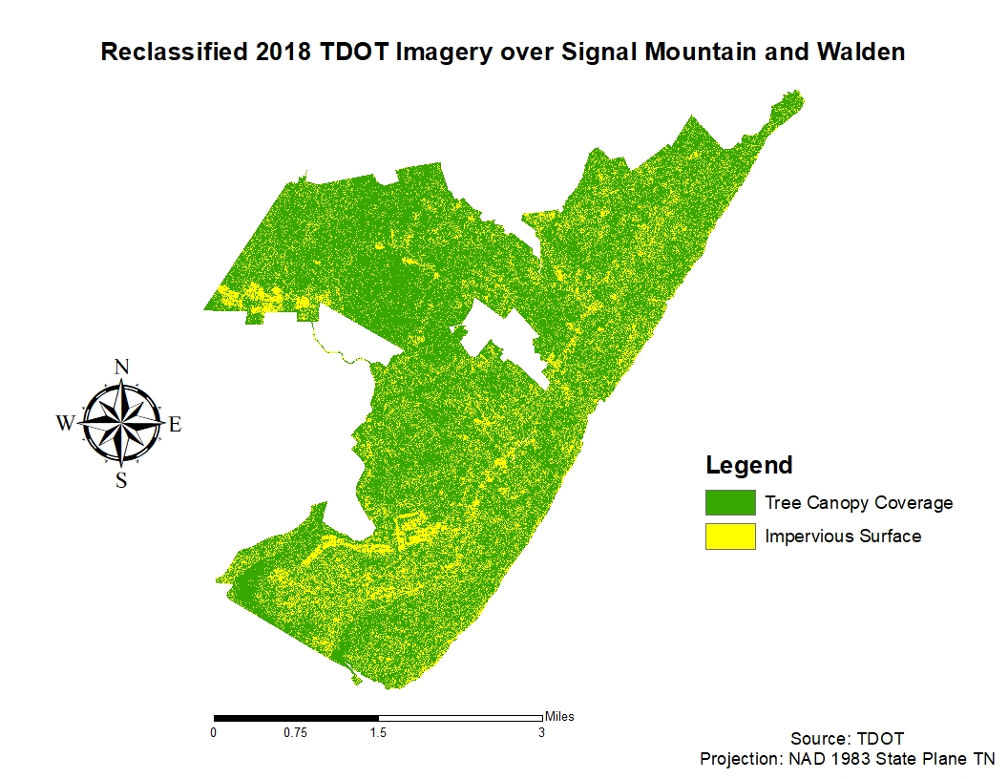
Unsupervised TDOT Data from 2010 to 2018

Slide 14
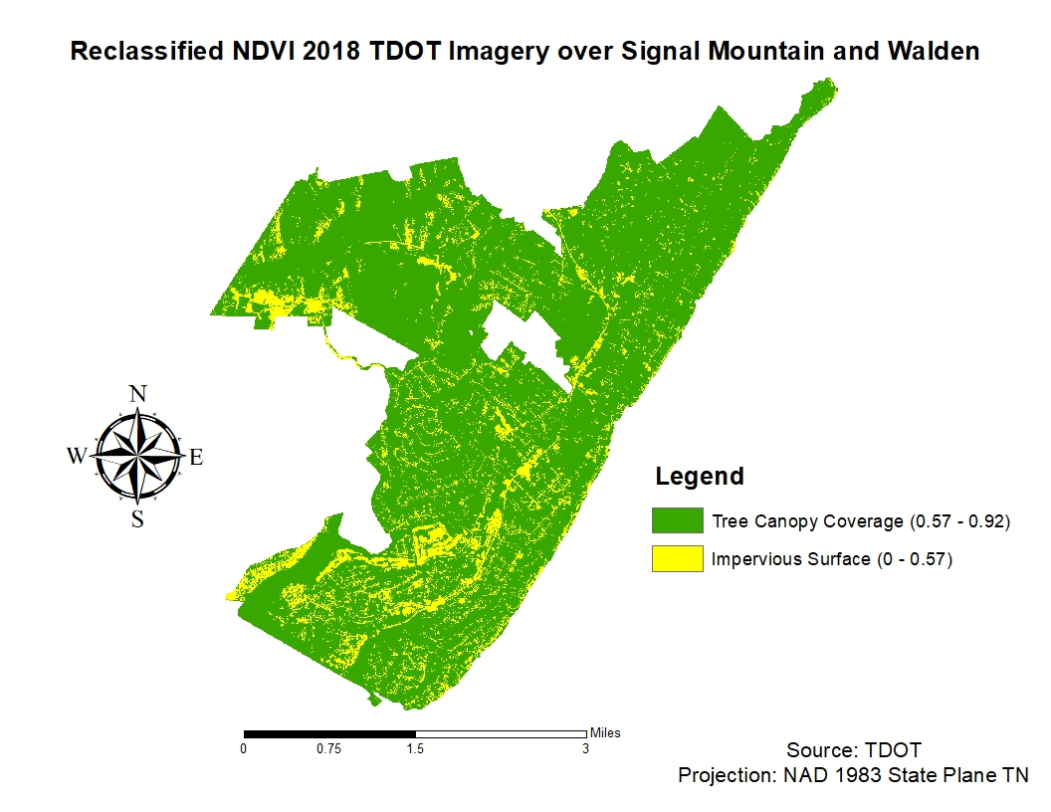
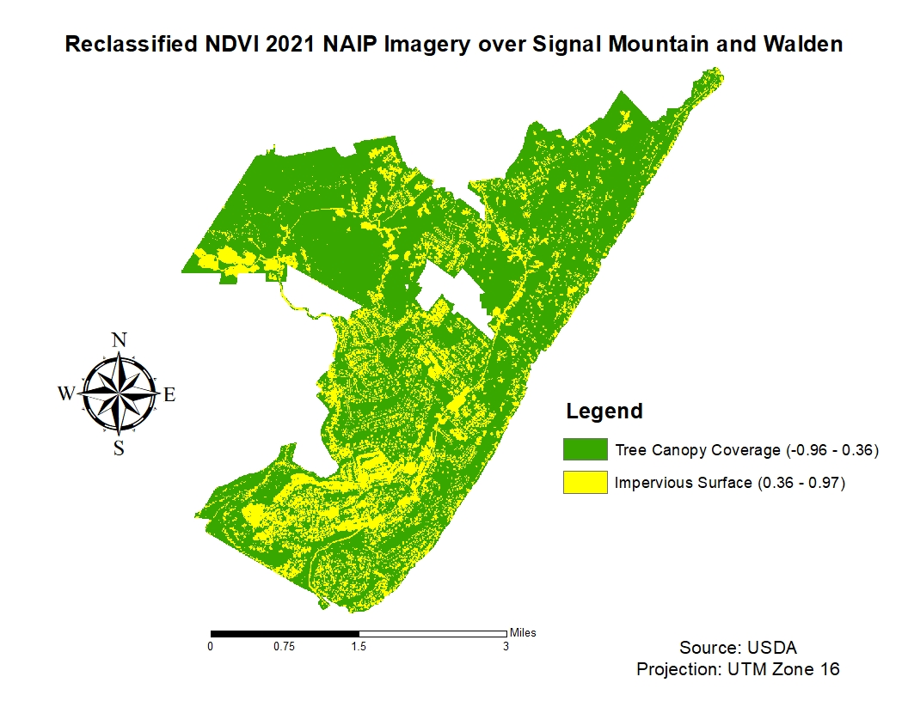
NDVI Analysis

Slide 15
Numerical Analysis Results
 | 2010 NAIP | 2021 NAIP | 2010 TDOT | 2018 TDOT
Unsupervised | C= 10.11 sq. miles (85%) IM= 1.78 sq. miles (15%) | C= 8.77 sq. miles (73.8%) IM= 3.12 sq. mile (26.2%) | C= 9.16 sq. miles (76.9%) IM= 2.74 sq. mile (23.1%) | C= 8.83 sq. miles (74.26%) IM= 3.06 sq. mile (25.74%)
NDVI |  | C= 8.74 sq. miles (73.5%) IM= 3.16 sq. miles (26.5%) |  | C= 9.19 sq. miles (77.3%) IM= 2.70 sq.miles (22.7%)
Dot Grid (all 3 years used 192 total points) |  | C= 59.38%, (114) IM= 40.62%, (78) | C= 68.75%, (132) IM= 31.25%, (60) | C= 60.42 %, (116) IM= 39.58 %, (76)

Slide 16
Conclusions
Across all analysis methods, we see a decrease in tree canopy coverage and an increase in impervious surface coverage from the earliest year to the latest year.
Unsupervised: The NAIP data showed a 11.1% decrease in canopy cover and a 11.1% increase in impervious surface cover from 2010 to 2021. The TDOT data showed a 2.64% decrease in canopy cover and a 2.64% increase in impervious surface cover from 2010 to 2018.
NDVI: Between the two classified NDVI images, there was a 3.8% decrease in canopy cover and a 3.8% increase in impervious surface cover from 2018 to 2021.
Dot Grid Analysis: Canopy cover decreased 8.33% from 2010 to 2018 and 1.04% from 2018 to 2021. Impervious surface coverage increased 8.33% from 2010 to 2018 and 1.04% from 2018 to 2021.
1997: 74.3% → 2010: 73.5% / 68.75% → 2018: 60.42% → 2021: 59.38%

Slide 17
Shortcomings & Suggestions for Improvement
Some of the main ways this study can be improved are through the development of a 3-class model for canopy/ impervious surface cover change instead of the 2-class model we used, the use of high-resolution 2010 imagery with an NIR band available, the use of a 3/16 mile grid instead of the 1/4 mile grid we used, and the division of analyses between Signal Mountain and Walden.
The development of a 3-class model would allow for the variability of land cover types within Signal Mountain and Walden to be better represented in our calculations. Any pixel that was not explicitly canopy cover had to be counted as an impervious surface. The creation of an “other” class would allow for water, crop fields, bare soil, and non-canopy vegetation to be excluded from the impervious surface class and provide results more consistent with Bruce Webster’s 2012 report.
Our 2010 NAIP and TDOT images lacked an NIR band which could have been used for NDVI calculation. This analysis method paired with the 3-class model has the potential to produce extremely accurate results if threshold values between canopy cover, impervious surface cover, and “other” land cover types can be accurately derived.
The use of a 3/16 mile grid would have kept methodology more consistent between the original report and our own.
Performing separate analyses on Signal Mountain and Walden would have also kept methodology more consistent between the original report and our own.
Finally, our inexperience with filtering processes for high-resolution images allowed for shadows to alter some reflection values, especially in unsupervised classification, which undoubtedly affected our results.

